Slide 1
COURSE NAME – cloud devops(epam)
COURSE CODE – 22cs2243f
Topic:
modules in terraform

Slide 2
AIM OF THE SESSION
To familiarize students with the basic concept agile modeling
INSTRUCTIONAL OBJECTIVES
This Session is designed to:
Demonstrate Terraform Architecture
Describe Terraform components
LEARNING OUTCOMES
At the end of this session, you should be able to:
Define Terraform Architecture
Describe Terraform components
2

Slide 3

SESSION INTRODUCTION
AGENDA
Terraform Architecture
Terraform Components

Slide 4
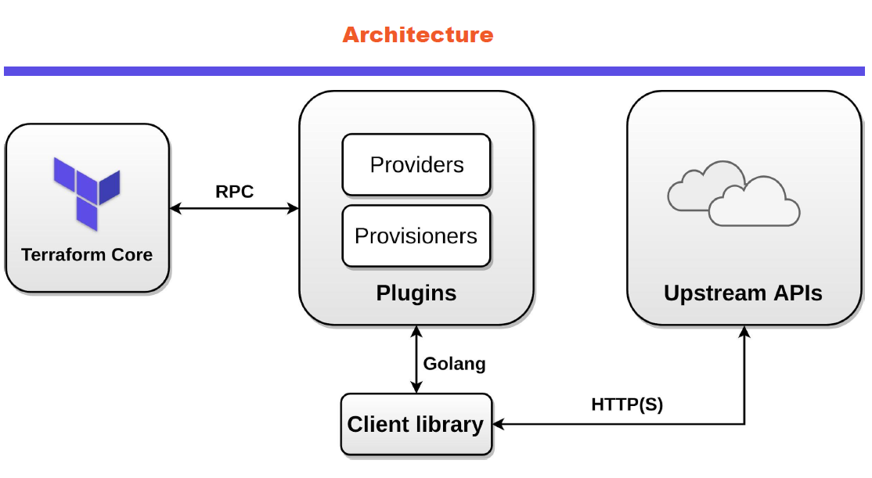
SESSION DESCRIPTION
Terraform Architecture

Slide 5
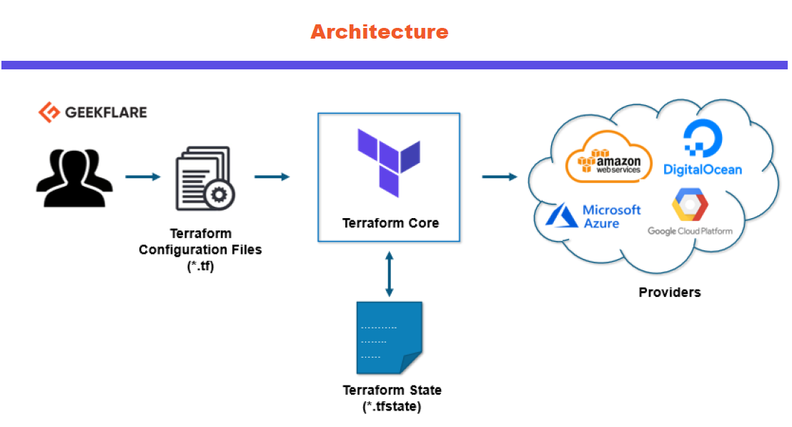
Terraform Architecture

Slide 6
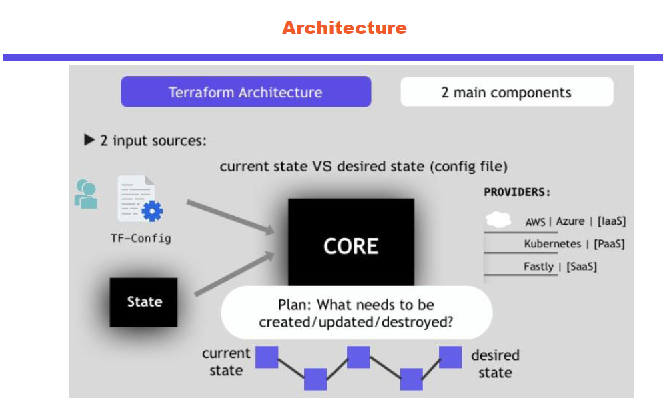
Terraform Architecture

Slide 7
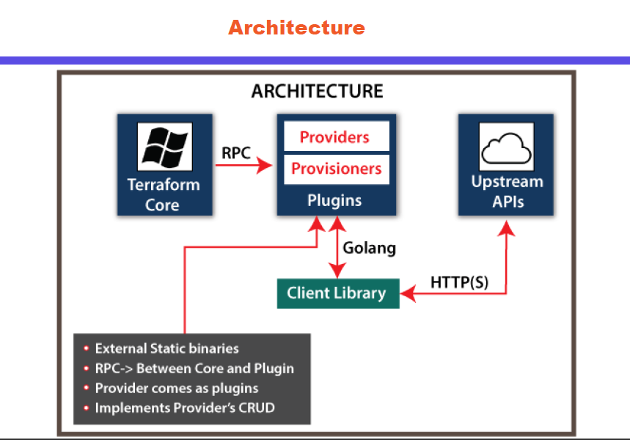
Terraform Architecture

Slide 8
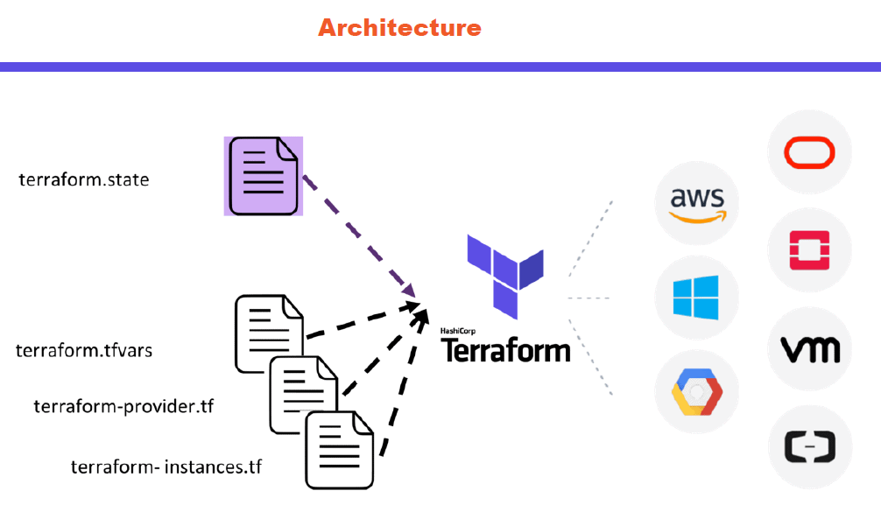
Terraform Architecture

Slide 9
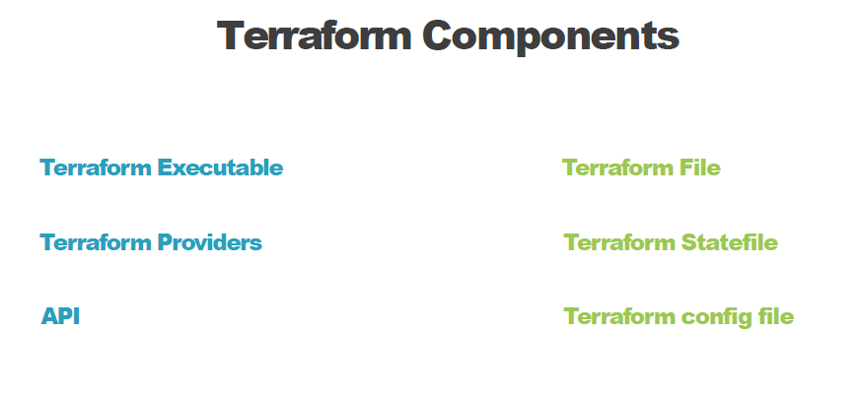
Terraform Components

Slide 10
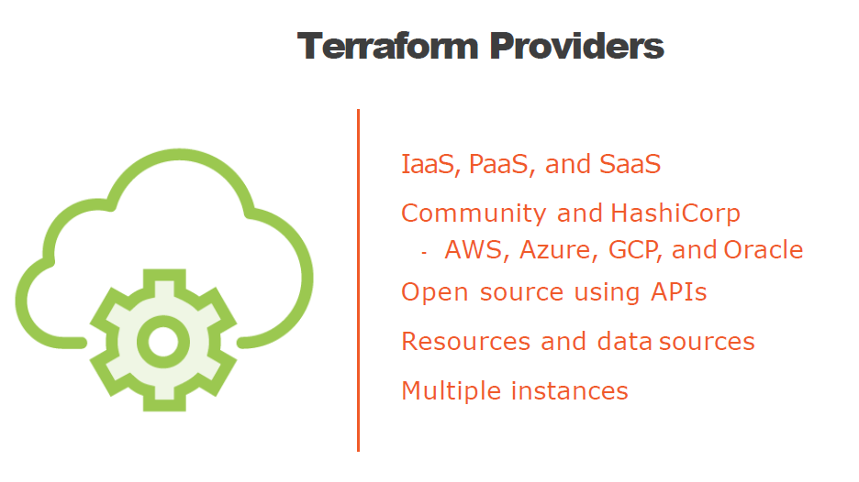
Terraform Providers

Slide 11
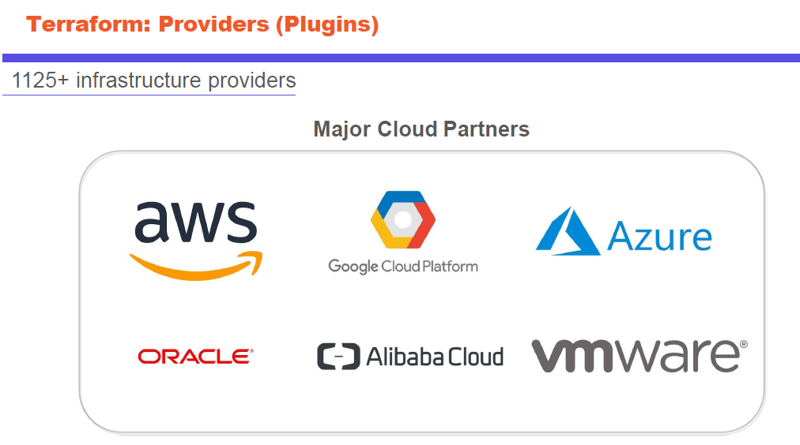
Terraform providers

Slide 12
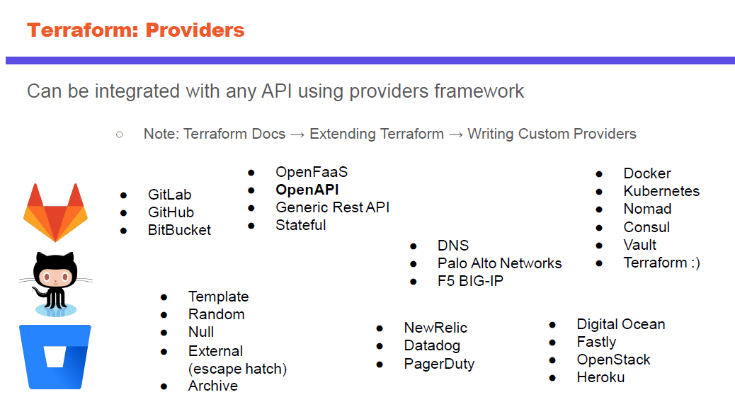
Terraform providers

Slide 13
SELF-ASSESSMENT QUESTIONS
Define Terraform Architecture ?
List out the Terraform components?

Slide 14
THANK YOU
Team – Continuous Delivery and devops

